Slide 1
350 COMPRESSOR PROCEDURE MANUAL

Slide 2
IMPORTANT: CHECK ENGINE OIL (0-30 synthetic) , ANITIFREEZE LEVEL IN THE KUBOTA ENGINE AND THE COMPRESSOR OIL ( SH 46 synthetic) IN THE 350 COMPRESSORS. MAKE SURE THERE IS NO DEBRIS IN OR AROUND THE COMPRESSOR DRIVE BELT. DO NOT FOR ANY REASON USE ETHER OR ANY OTHER STARTER FLUID

Slide 3
COMPRESSOR DIP STICK (LOCATED BETWEEN THE ENGINE AND THE COMPRESSOR)

Slide 4
WINTER: ADD SAFETY BRAKE INTO LUBRICATOR AND USE THE ADJUST MENT KNOB TO HAVE A DROP EVERY 5-6 SECONDS DEPENDING ON THE WEATHER CONDITIONS . BEFORE REMOVING THE LUBRICATOR FILLER CAP MAKE SURE THE AIR IS ISOLATED AND DRAINED FROM THE LUBRICATOR
ADJUST
FILL

Slide 5
MAKE SURE THE AIR TANK RECIEVER HAS BEEN DRAINED AND PURGED OF CONDENSATION FROM THE NIGHT BEFORE.

Slide 6
IMPORTANT: MAKE SURE THE CLUTCH IS NOT ENGAGED BEFORE STARTING ENGINE.

Slide 7
START UP PROCEDURE

Slide 8
MAKE SURE THE MASTER SWITCH IS TURNED ON (TURN MASTER SWITCH OFF WHEN THE EQUIPMENT IS NOT BEING USED FOR EXTENDED AMOUT OF TIME)

Slide 9
PRESS IN RED BUTTON AND HOLD WHILE TURNING THE KEY TO START. CONTINUE TO HOLD RED BUTTON WHEN ENGINE STARTS UNTIL OIL PRESSURE IS AT ADEQUATE PRESSURE 28-40 PSI IMPORTANT: TO AVOID UNNECESSARY DAMAGES AND DOWN TIME, LET THE EQUIPMENT COME UP TO OPERATING TEMPERATURES 5-10 MINS DEPENDING ON WEATHER CONDITIONS BEFORE IDLING UP THE ENGINE AND ENGAGING THE CLUTCH. WINTER: TURN THE KEY TO THE LEFT AND HOLD FOR 1 MIN TO ACTIVATE GLOW PLUG DO NOT FOR ANY REASON USE ETHER OR ANY OTHER STARTER FLUID

Slide 10
ONCE THE ENGINE HAS HAD A CHANCE TO WARM UP, PROCEED TO IDLE UP ENGINE TO AROUND 1500 RPM AND ENGAGE THE CLUTCH ON THE COMPRESSOR SLOWLY ENGAGING THE CLUTCH PLATES AND ALLOWING THE COMPRESSOR TO COME UP TO ENGINE RPM. ONCE THE COMPRESSOR HAS HAD A CHANCE TO MATCH RPM, AT THIS TIME TURN RPMS UP TO 3000 RPM.
WINTER: DEPENDING ON TEMPERATURE YOU MIGHT HAVE TO RAISE THE RPM BETWEEN 2000-2500 AND SLOWLY ENGAGE THE COMPRESSOR CLUTCH PLATES AND WAIT FOR THE COMPRESSOR TO MATCH RPM.
SUGGESTION: IN EXTREME COLD TEMPERATURES, USE THE BLOCK HEATER ON THE ENGINE AND SAFELY HEAT THE TARPED IN AREA OF THE COMPRESSOR TO SPEED UP STARTUP TIME AND AVOID ANY UNNECESSARY DOWNTIME OR DELAYS.

Slide 11
AT 3000 RPM THE COMPRESSOR WILL PUT OUT 250 PSI TO THE RECIEVER TANK.

Slide 12
THE AIR FEED LINE TO THE EQUIPMENT WILL BE SET AT A RANGE OF 190 TO 220 PSI DEPENDING ON THE EQUIPMENT IT IS DESIGNATED TO RUN WITH. NEVER RUN THE COMPRESSOR FEED TO THE EQUIPMENT ABOVE 220 PSI. THIS MAY DAMAGE THE SEALS OF THE EQUIPMENT AND CAUSE EXTENDED AMOUNT OF DOWN TIME.

Slide 13
SHUTTING DOWN THE EQUIPMENT

Slide 14
WHEN SHUTTING DOWN FOR THE DAY, LOWER THE RPM OF THE ENGINE AND DISENGAGE THE CLUTCH AND LET THE ENGINE IDLE AT LOW RPMS FOR A FEW MINUTES TO COOL DOWNTHE ENGINE BEFORE SHUTTING IT DOWN.

Slide 15
MAKE SURE TO DRAIN THE AIR AND CONDENSATION OUT OF THE AIR RECIEVER TANK.

Slide 16
NOTE: IF SHUTTING DOWN FOR LONG PERIODS OF TIME USE THE MASTER SWITCH TO TERMINATE ANY POWER. EXTREME COLD TEMPERATURES : TO HELP WITH UNECESSARY DOWN TIME PLEASE PLUG IN BLOCK HEATER INTO A POWER SOURCE AND HEAT THE COMPRESSOR UNIT WITH A SAFE AND RELIABLE HEAT SOURCE

Slide 17
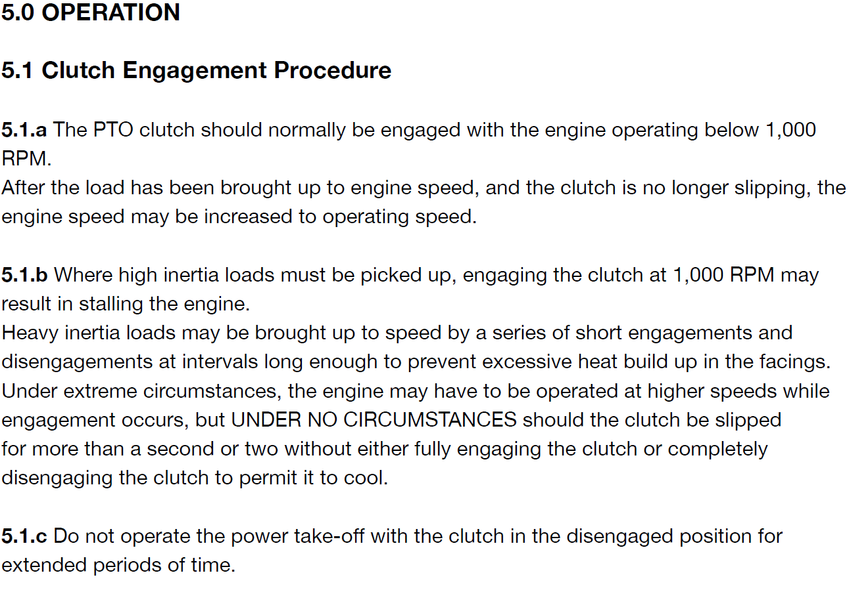
MANUFACTURES PROCEDURES NAC CLUTCH

